Slide 1
Rollerball Iteration II
Team The Best Team

Slide 2
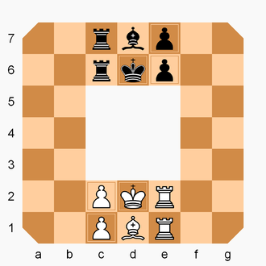

Rollerball

Slide 3
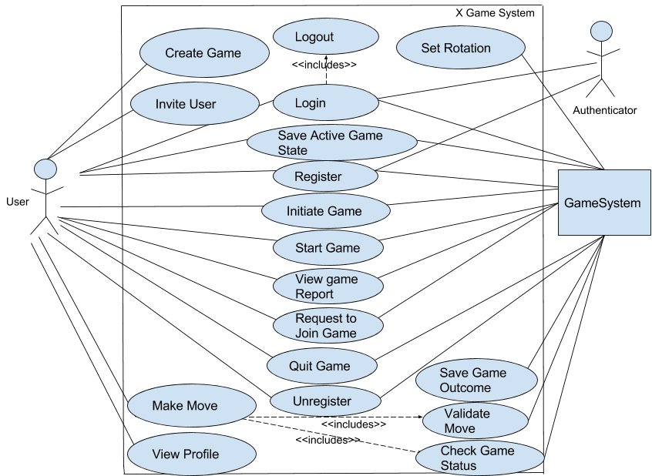
Old Use Case Diagram

Slide 4
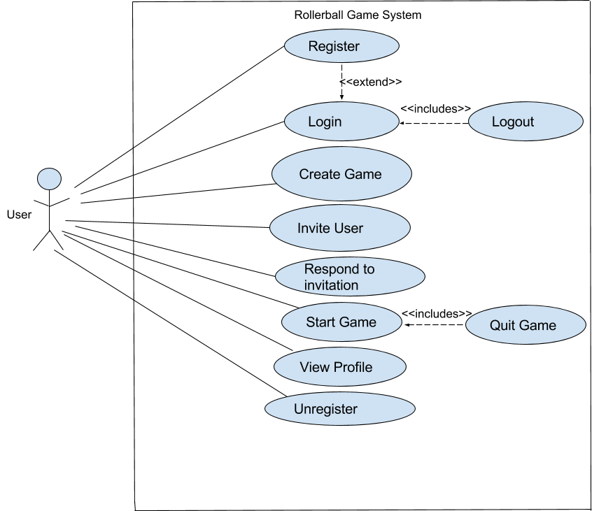
Updated Use Case

Slide 5
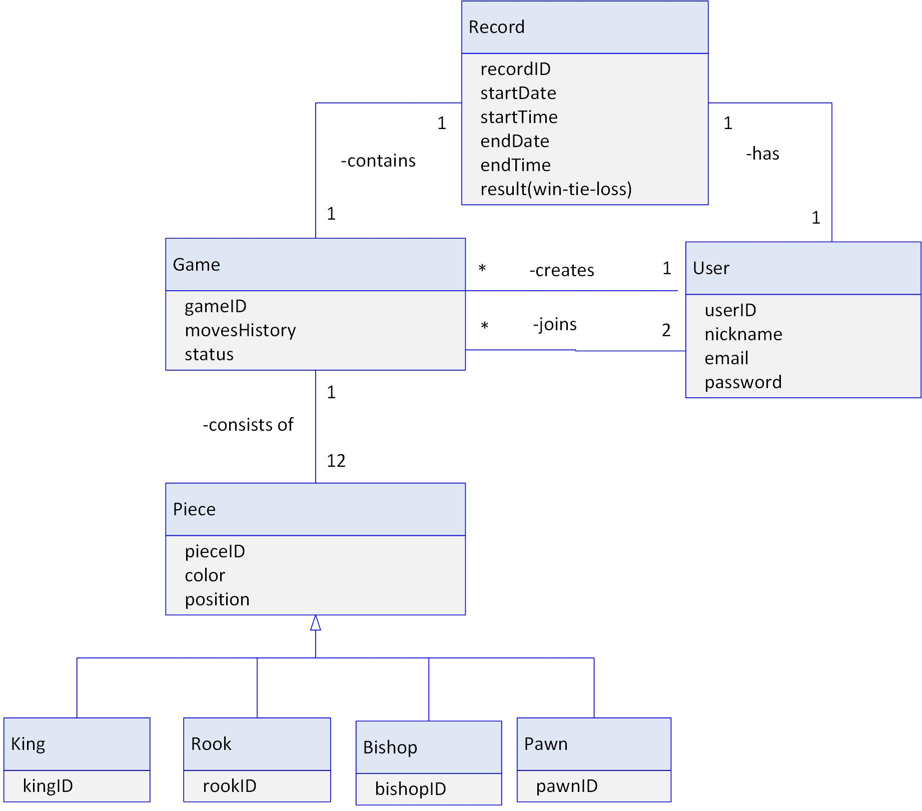
Domain Model

Slide 6
Project Decisions
Configuration Class
Connect And Test Database
Test database
Stores Username, Email, and Password
MySQL DB

Slide 7

Questions

